Slide 1
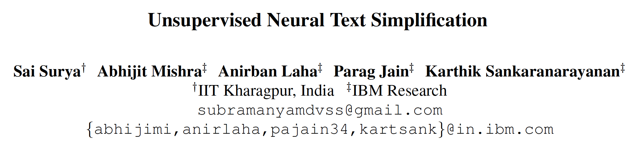
2020/02/17 Paper reading
Slides made by Song

Slide 2
Overview
Introduction
Related work
Motivation
Proposed method
Experiment setting
Result
Conclusion

Slide 3
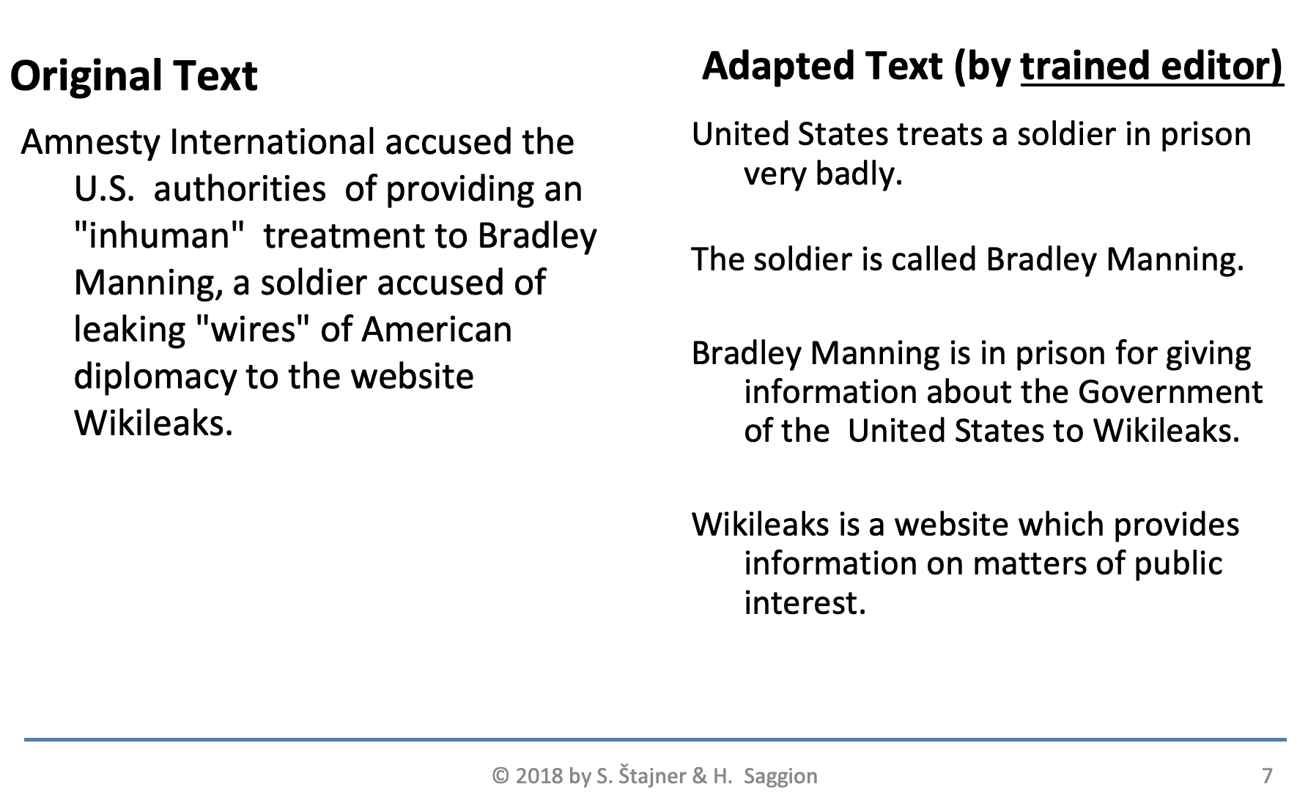
Introduction
Text Simplification (TS):
Simplify aspects:
Lexical: Complex words
Syntactic: Hierarchical structures

Slide 4
Related work
1. Rule based: Chandrasekar and Srinivas (1997)
2. Modular system: Canning and Tait (1999)
3. Data-driven:
  Statistical: Phrase-based SMT (Specia, 2010; Stajner et al., 2015)
  Neural: (Wang et al., 2016; Nisioi et al., 2017)

Slide 5
Motivation
Supervised VS Unsupervised
Method | Data | Limitation (Solution)
Supervised Neural TS (NTS) (Wang et al., 2016; Nisioi et al., 2017) | Parallel Original-Simplified data | 1) No (less) parallel data for new language 2) Noise in current parallel dataset
Unsupervised Neural TS (UNTS) | Complex sentence dataset + Simple sentence dataset | Do not need original-simplified parallel data

Slide 6
Motivation
Previous unsupervised method VS proposed
Method | Limitation (Solution)
Unsupervised lexical simplification (Paetzold and Specia, 2016) | Only complex → simple words No syntactic level simplification.
UNTS | Both lexical and syntactic level.

Slide 7





Proposed method
Encode-attend-decode architecture
Attention of Gs
Simple sentence Decoder
Encoder
Attention of Gd
Complex sentence Decoder

Slide 8


Proposed method
Input and output
Output: Context vector
Simple sentence Decoder
Output:
Simple sentence Y=[y1, ...ym]
Input:
sentence X=[x1, ...xn]
Encoder
Output: Context vector
Complex sentence Decoder
Output:
Complex sentence Y=[y1, ...ym]
: Simple sentence
: Complex sentence

Slide 9
Proposed method
Final goal:
Simple sentence Decoder
Output:
Simple sentence Y=[y1, ...ym]
Input:
Complex sentence Xd=[x1, ...xn]
Encoder
Complex sentence Decoder

Slide 10
Proposed method
Training goal (task): （1 Reconstruction
Simple sentence Decoder
Output: Should be the same as input
Input: Simple sentence
Encoder
Complex sentence Decoder

Slide 11
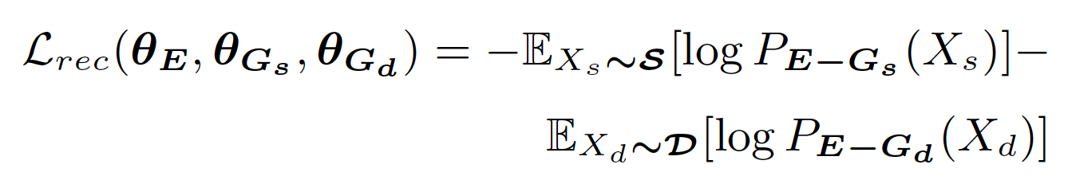
Proposed method
Training goal (task): （1 Reconstruction
Simple sentence Decoder
Input: Complex sentence
Encoder
Complex sentence Decoder
Output: Should the same as input
Loss:

Slide 12
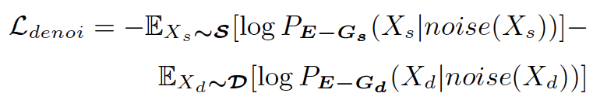
Proposed method
Training goal: （2 Denoise
Simple sentence Decoder
Output: Denoised sentence
Input: Sentence with noise
(Swap bigrams)
If in simple set
Encoder
If complex
Complex sentence Decoder
Output: Denoised sentence

Slide 13
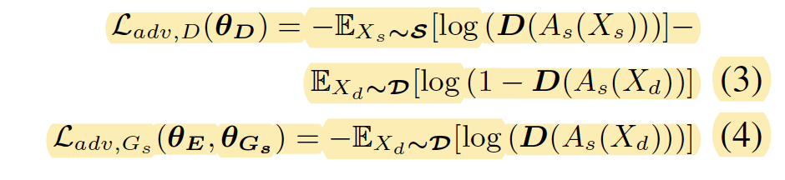
Proposed method
Training goal:
  (3 Simple decoder can process complex sentence
Input: Simple sentence
GAN way:
Encoder
Simple sentence Decoder
Context vector
As (Xs)
Discriminator
Input: Complex sentence
Encoder
Simple sentence Decoder
Context vector
As (Xd)
Make As(Xs) and As(Xd) with similar data distribution

Slide 14
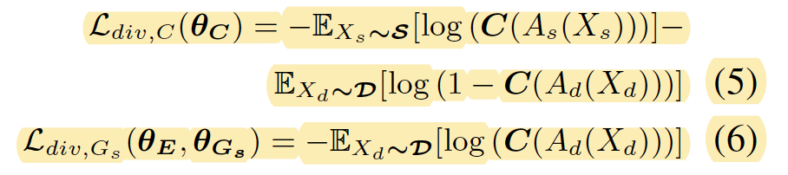
Proposed method
Training goal:
  (4 Context vector of simple sentence should be different from that of complex sentence
Input: Simple sentence
Encoder
Simple sentence Decoder
Context vector
As (Xs)
Classifier
Input: Complex sentence
Encoder
Complex sentence Decoder
Context vector
Ad (Xd)
Make As(Xs) and Ad(Xd) with different data distribution

Slide 15
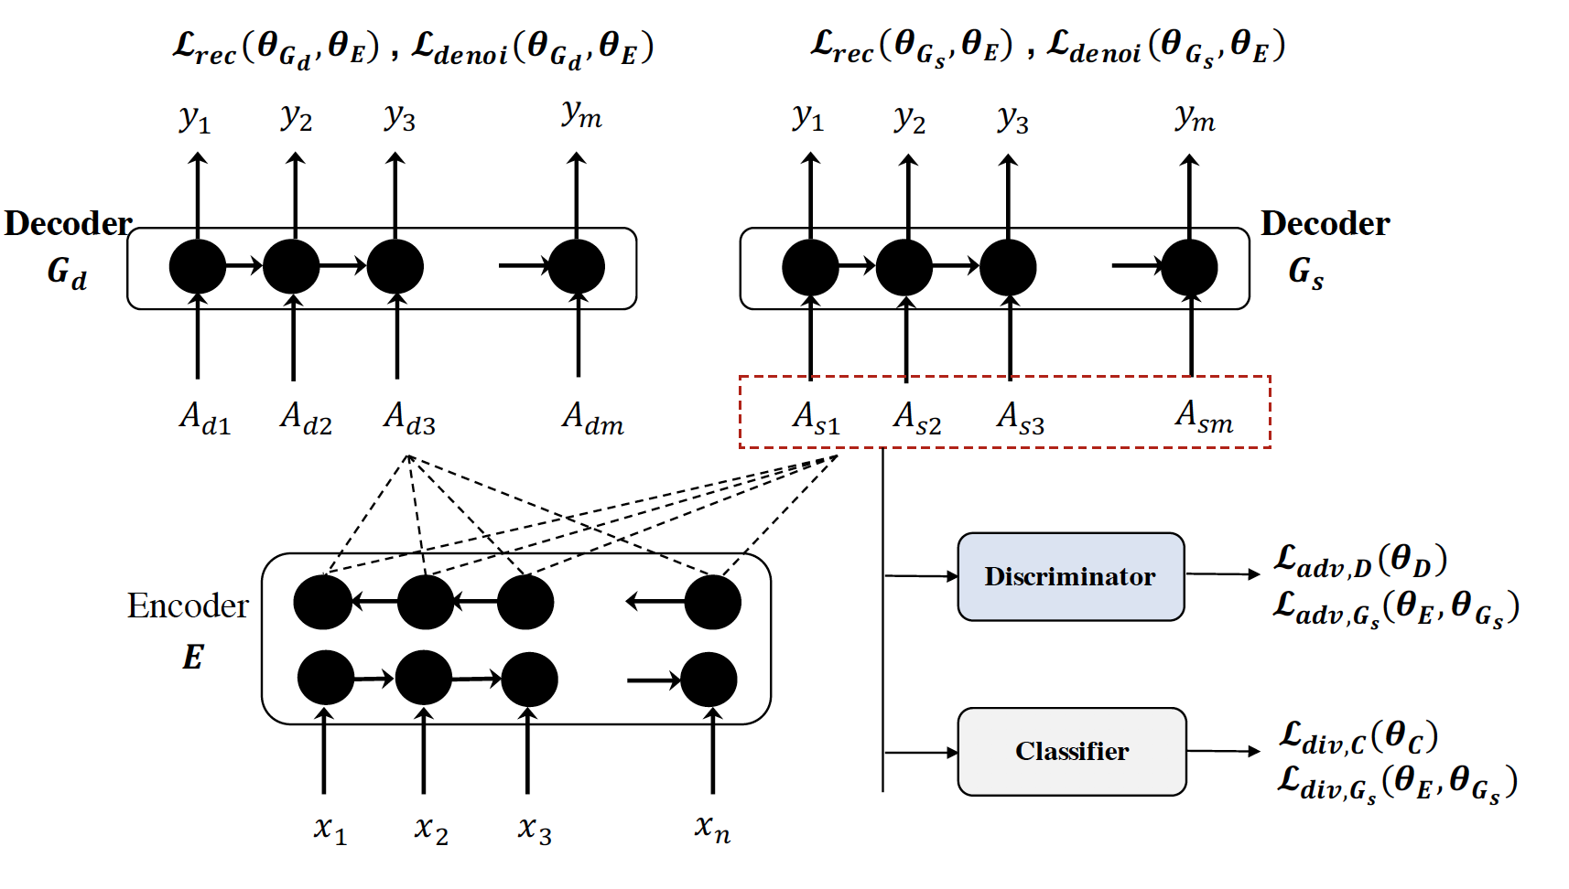
Proposed method
Graph from the paper

Slide 16
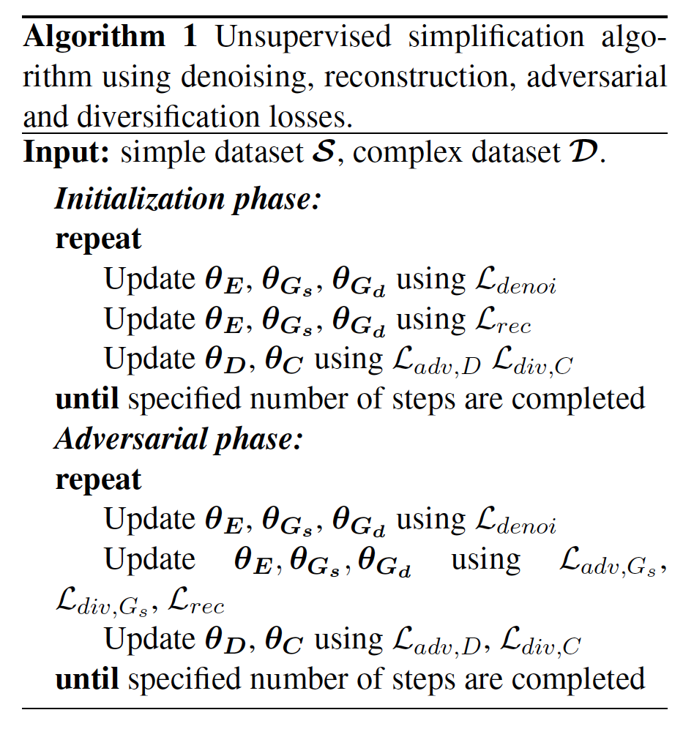
Training process

Slide 17
Experiment setting
Dataset
 | Dataset | Description
Train | en-wikipedia | Readability score: categorize complex simple sentences
Dev (Xu et al., 2016) | 2000 sentences | each with 8 references
Test (Xu et al., 2016) | 359 sentences | each with 8 references

Slide 18
Experiment setting
Evaluation
 | Metric
Model selection | Automatic metric such as: BLEU and Word Difference
Test set evaluation | Human evaluation: Simpleness: [0, 1] Grammaticality: fluency [1-5] Relatedness: meaning [1-5] (higher->better)

Slide 19
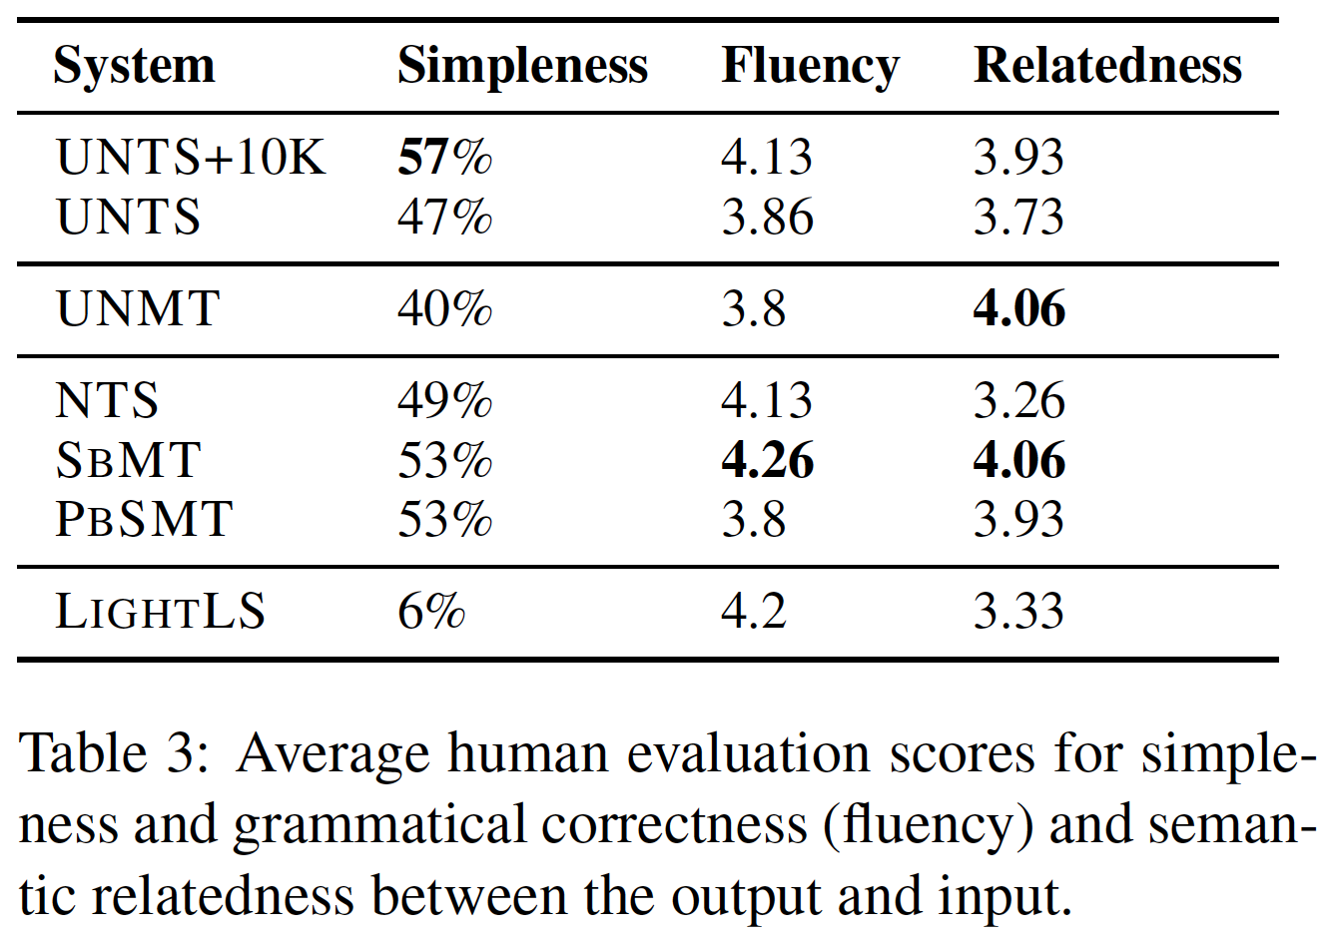
Results
X% sentences are simplified
The higher, the better
Proposed semi-supervised
Proposed Unsupervised
Unsupervised NMT
Supervised Neural TS
Syntax based MT
Phrase-based SMT
Unsupervised lexical simplification system

Slide 20
Conclusion:
Novel attempt towards unsupervised text simplification.
(Including) Novel model and training process.
Better than or competitive to these baselines

